Slide 1
Risk identification
Checklist Analysis
Brainstorming
SWOT Analysis
Flowchart Method
Thinking Pessimistically
Seek Employee Feedback
Delphi Technique
Root Cause Analysis
Interviewing

Slide 2
Checklist Analysis
Checklist Analysis is type of technique generally used to identify or find risks and manage it. The checklist is basically developed by listing items, steps, or even tasks and is then further analyzed against criteria to just identify and determine if procedure is completed correctly or not.

Slide 3
Risk | Risk Reduction Technique
Personnel Shortfalls | Various techniques include training and career development, job-matching, teambuilding, etc.
Unrealistic time and cost estimates | Various techniques include incremental development, standardization of methods, recording, and analysis of the past project, etc.
Development of wrong software functions | Various techniques include formal specification methods, user surveys, etc.
Development of the wrong user interface | Various techniques include user involvement, prototyping, etc.

Slide 4
Brainstorming
This technique provides and gives free and open approach that usually encourages each and everyone on project team to participate. It also results in greater sense of ownership of project risk, and team generally committed to managing risk for given time period of project. It is creative and unique technique to gather risks spontaneously by team members. The team members identify and determine risks in ‘no wrong answer’ environment.

Slide 5
SWOT Analysis
Strengths-Weaknesses-Opportunities-Threat (SWOT) is very technique and helpful for identifying risks within greater organization context. It is generally used as planning tool for analyzing business, its resources, and also its environment simply by looking at internal strengths and weaknesses and opportunities and threats in external environment.

Slide 6
Flowchart Method
This method allows for dynamic process to be diagrammatically represented in paper. This method is generally used to represent activities of process graphically and sequentially to simply identify the risk.

Slide 7
Thinking Pessimistically
Although pessimism isn’t often encouraged in the workplace, taking time to ponder “what is the worst possible thing that could happen to the company” may be helpful in identifying risks.

Slide 8
Seek Employee Feedback
Upper-level management’s perspective of an organization’s risks can be starkly different from the perspective that employees hold. Employees may encounter new risks in their day-to-day activities that may not have otherwise been encountered. For example, insufficient training on a piece of operating equipment may be placing staff at risk of injury. As such, employees are an invaluable source of first-hand information.

Slide 9
Delphi Technique
A team of experts is consulted anonymously. A list of required information is sent to experts, responses are compiled, and results are sent back to them for further review until a consensus is reached.

Slide 10
Root Cause Analysis
Root causes are determined for the identified risks. These root causes are further used to identify additional risks.

Slide 11
Interviewing
An interview is conducted with project participants, stakeholders, experts, etc to identify risks.

Slide 12
Risk projection
also called risk estimation, attempts to rate each risk in two ways—the likelihood or probability that the risk is real and the consequences of the problems associated with the risk, should it occur. The project planner, along with other managers and technical staff, performs four risk projection activities:

Slide 13
(1) establish a scale that reflects the perceived likelihood of a risk,
(2) delineate the consequences of the risk,
(3) estimate the impact of the risk on the project and the product, and
(4)note the overall accuracy of the risk projection so that there will be no misunderstandings.

Slide 14
Developing a Risk Table
A risk table provides a project manager with a simple technique for risk projection.
A project team begins by listing all risks in the first column of the table.
Each risk is categorized in the second column
The probability of occurrence of each risk is entered in the next column of the table.

Slide 15
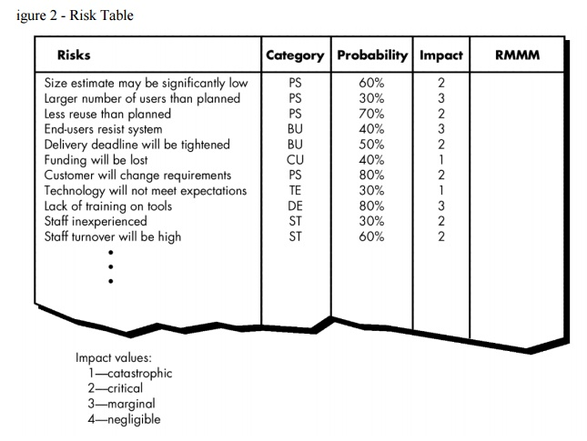

Slide 16
Assessing Risk Impact
Three factors determine the consequences if a risk occurs
Nature of the risk - the problems that are likely if it occurs.
Scope of a risk - combines the severity with its overall distribution (how much of the project will be affected or how many customers are harmed?).
Timing of a risk - when and how long the impact will be felt.

Slide 17
Risk Exposure
RE, determined using
RE = P x C
P is the probability of occurrence for a risk.
C is the cost to the project should the risk occur.

Slide 18
Risk Refinement
During early stages of project planning, a risk may be stated quite generally. As time passes and more is learned about the project and the risk, it may be possible to refine the risk into a set of more detailed risks, each somewhat easier to mitigate, monitor, and manage.
One way to do this is to represent the risk in condition-transition-consequence (CTC) format .

Slide 19
Given that all reusable software components must conform to specific design standards and that some do not conform, then there is concern that (possibly) only 70 percent of the planned reusable modules may actually be integrated into the as-built system, resulting in the need to custom engineer the remaining 30 percent of components.

Slide 20
This general condition can be refined in the following manner:
Subcondition 1. Certain reusable components were developed by a third party with no knowledge of internal design standards.
Subcondition 2. The design standard for component interfaces has not been solidified and may not conform to certain existing reusable components.
Subcondition 3. Certain reusable components have been implemented in a language that is not supported on the target environment.

Slide 21
RMMM
stands for risk mitigation, monitoring and management. There are three issues in strategy for handling the risk is
Risk Avoidance
Risk monitoring
Risk management

Slide 22
Risk Mitigation
Communicate with the concerned staff to find of probable risk.
Find out and eliminate all those causes that can create rick before the project starts.
Develop a policy in an organization which will help to continue the project even though some staff leaves the organization.
Everybody in the project team should be acquainted with the current development activity.
Maintain the corresponding documents in timely manner. This documentation should be strictly as per the standards set by the organization.
Conduct timely reviews in order to speed up the work.
For conducting every critical activity during software development, provide the additional staff if required.

Slide 23
Risk Monitoring
The approach of the team members as pressure of project varies.
The degree in which the team performs with the spirit of "team-work".
The type of co-operation among the team members. Availability of jobs within and outside the organization.
If the current development activity is monitored continuously then everybody in the team will get acquainted with current development activity.
The objective of risk monitoring is to check whether the predicted risks really occur or not. To ensure the step defined to avoid the risk are applied properly or not. To gather the information which can be useful for analyzing the risk.

Slide 24
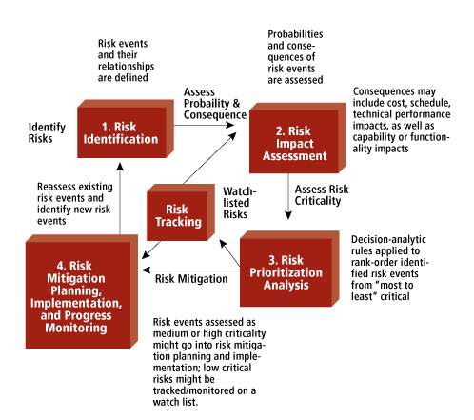
Risk management

